Slide 1
Huffman Coding

Slide 2
Data Compression
Suppose we have 1000000000 (1G) character data file that we wish to include in an email.
Suppose file only contains 26 letters {a,…,z}.
Suppose each letter α in {a,…,z} occurs with frequency f_{α}.
Suppose we encode each letter by a binary code
If we use a fixed length code, we need 5 bits for each character
The resulting message length is
Can we do better?

Slide 3
Huffman Codes
Most character code systems (ASCII, unicode) use fixed length encoding
If frequency data is available and there is a wide variety of frequencies, variable length encoding can save 20% to 90% space
Which characters should we assign shorter codes; which characters will have longer codes?

Slide 4
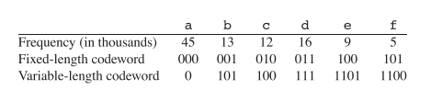
Data Compression: A Smaller Example
Suppose the file size is 100000 characters and contains only 6 letters {a,b,c,d,e,f} with frequencies
Fixed length 3*100000=300000 bits
Variable length

Slide 5
How to decode?
At first it is not obvious how decoding will happen, but this is possible if we use prefix codes
no codeword is also a preﬁx of some other codeword

Slide 6
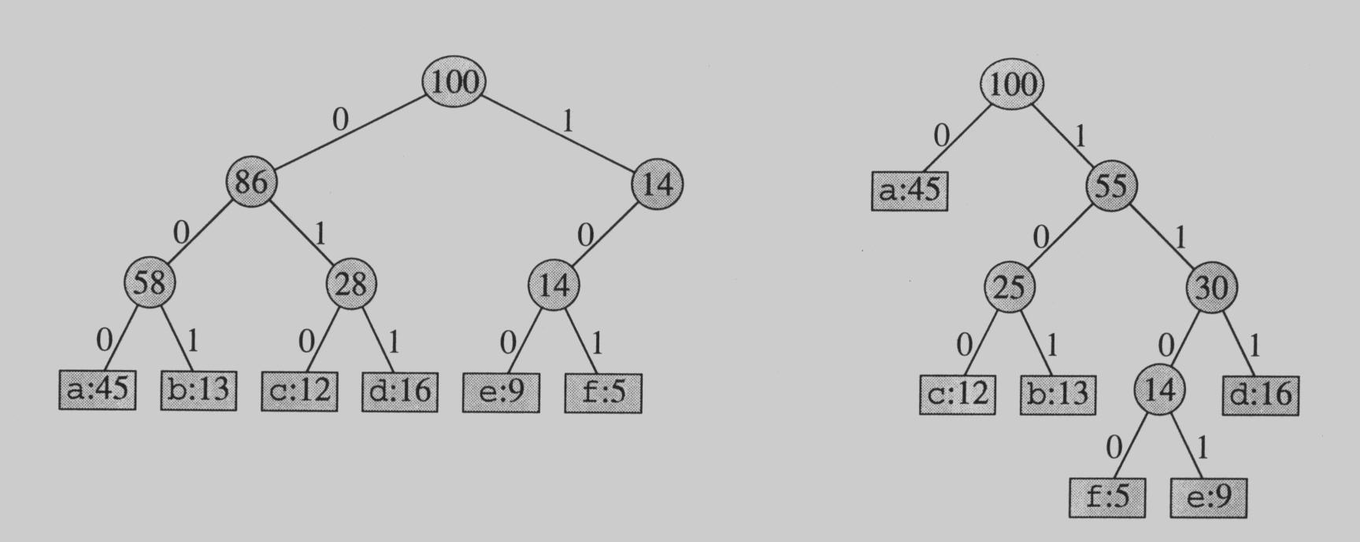
Prefix Codes
The variable-length codes assigned to input characters are Prefix Codes, means the codes (bit sequences) are assigned in such a way that the code assigned to one character is not the prefix of code assigned to any other character. This is how Huffman Coding makes sure that there is no ambiguity when decoding the generated bitstream.
By using a binary tree representation we will generate prefix codes provided all letters are leaves

Slide 7
Prefix codes
A message can be decoded uniquely.
Following the tree until it reaches to a leaf, and then repeat!
Draw a few more tree and produce the codes!!!

Slide 8
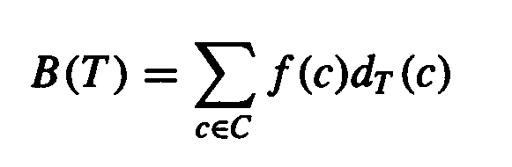
Some Properties
Prefix codes allow easy decoding
Given a: 0, b: 101, c: 100, d: 111, e: 1101, f: 1100
Decode 001011101 going left to right, 0|01011101, a|0|1011101, a|a|101|1101, a|a|b|1101, a|a|b|e
An optimal code must be a full binary tree (a tree where every internal node has two children)
For C leaves there are C-1 internal nodes
The number of bits to encode a file is
where f(c) is the freq of c, d_{T}(c) is the tree depth of c, which corresponds to the code length of c

Slide 9
Optimal Prefix Coding Problem
Input: Given a set of n letters (c₁,…, c_{n}) with frequencies (f₁,…, f_{n}).
Construct a full binary tree T to define a prefix code that minimizes the average code length

Slide 10
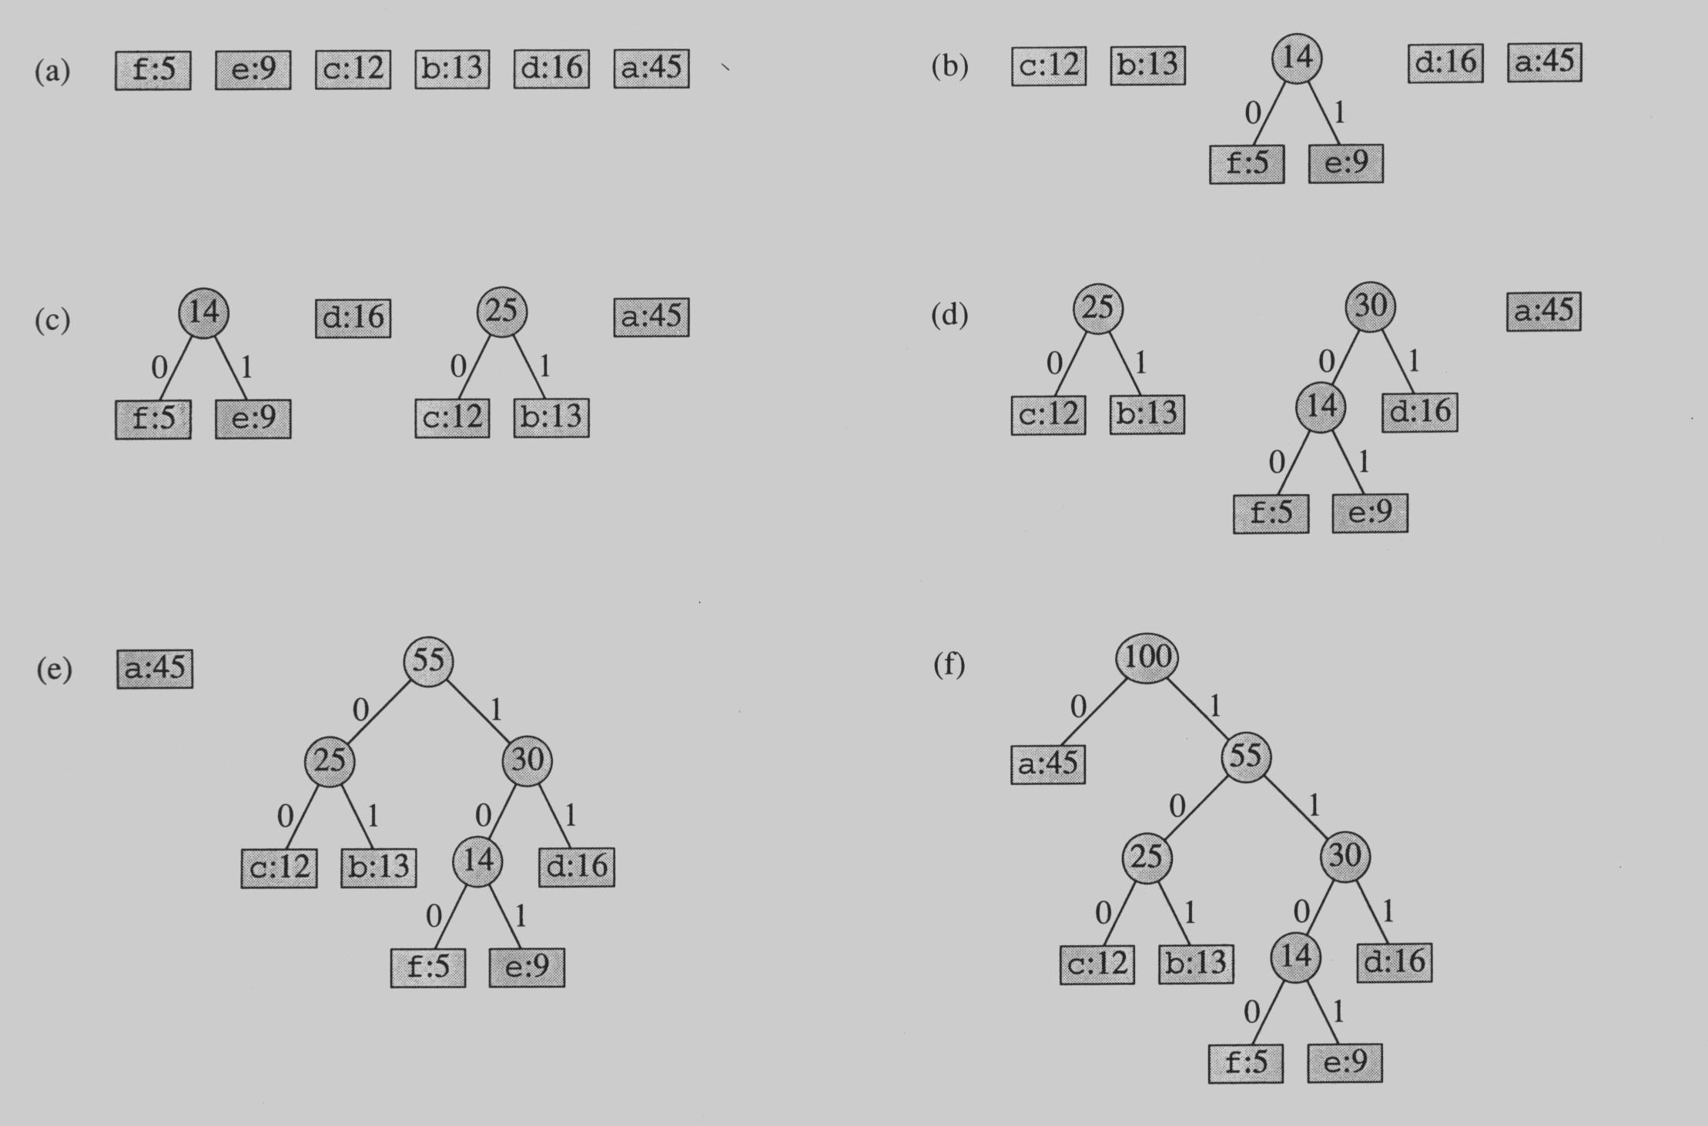
Building the Encoding Tree

Slide 11
Building the Encoding Tree

Slide 12
Building the Encoding Tree

Slide 13
Building the Encoding Tree

Slide 14
Building the Encoding Tree

Slide 15
Example:
Alphabet: A, B, C, D, E, F
Frequency table:
F | E | D | C | B | A
60 | 50 | 40 | 30 | 20 | 10
Total File Length: 210

Slide 16
The Huffman encoding:
A: 1000
B: 1001
C: 101
D: 00
E: 01
F: 11
V 210
0
1
Z 90
W 120
1
0
0
1
D 40
E 50
Y 60
F 60
1
0
X 30
C 30
0
1
A 10
B 20
File Size: 10x4 + 20x4 + 30x3 + 40x2 + 50x2 + 60x2 =
40 + 80 + 90 + 80 + 100 + 120 = 510 bits

Slide 17
Note the savings:
The Huffman code:
Required 510 bits for the file.
Fixed length code:
Need 3 bits for 1 characters.
File has 210 characters.
Total: 630 bits for the file.

Slide 18
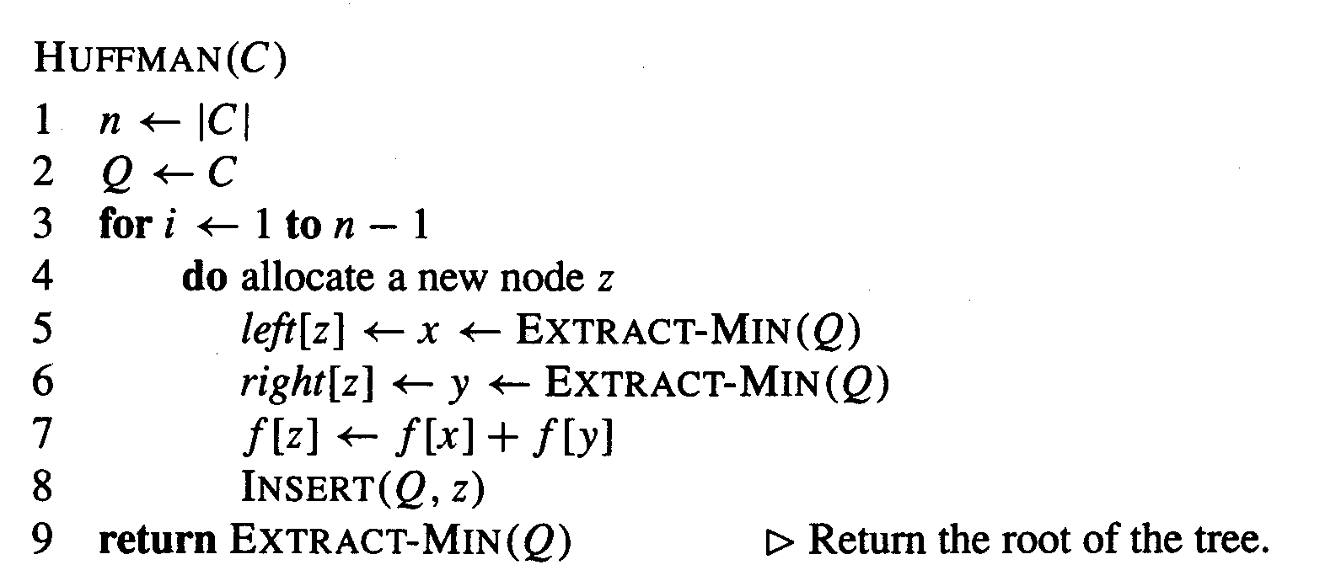
The Algorithm
An appropriate data structure is a binary min-heap
Rebuilding the heap is lg n and n-1 extractions are made, so the complexity is O( n lg n )
The encoding is NOT unique, other encoding may work just as well, but none will work better

Slide 19
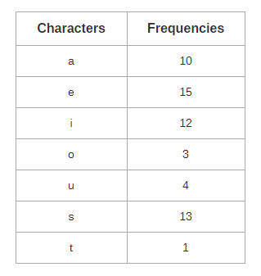
Example:

Slide 20
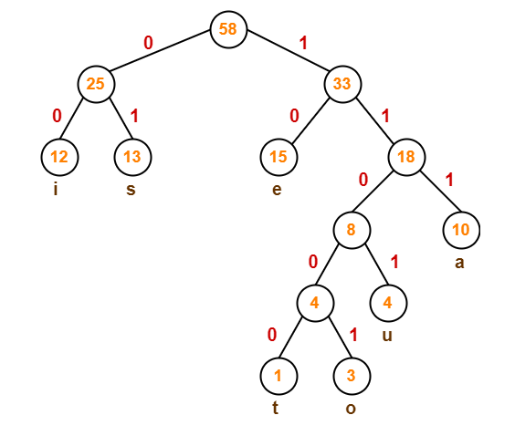
a = 111
e = 10
i = 00
o = 11001
u = 1101
s = 01
t = 11000

Slide 21
Average code length
= ∑ ( frequency_{i} x code length_{i} ) / ∑ ( frequency_{i} )
= { (10 x 3) + (15 x 2) + (12 x 2) + (3 x 5) + (4 x 4) + (13 x 2) + (1 x 5) } / (10 + 15 + 12 + 3 + 4 + 13 + 1)
= 2.52
Total number of bits in Huffman encoded message
= Total number of characters in the message x Average code length per character
= 58 x 2.52
= 146.16
≅ 147 bits

Slide 22
Problems
1. How many bits may be required for encoding the message ‘mississippi’?
Characters | Frequency
M | 1
P | 2
S | 4
I | 4
Characters | Code | Code length
M | 100 | 3
P | 101 | 3
S | 11 | 2
I | 0 | 1
Total number of bits = freq(m) * codelength(m) + freq(p) * code_length(p) + freq(s) * code_length(s) + freq(i) * code length(i) = 1*3 + 2*3 + 4*2 + 4*1 = 21
Also, average bits per character can be found as: Total number of bits required / total number of characters = 21/11 = 1.909

Slide 23
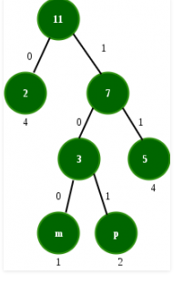
Problem 1 huffman tree

Slide 24
Problem
2. The characters a to h have the set of frequencies based on the first 8 Fibonacci numbers as follows:
a : 1, b : 1, c : 2, d : 3, e : 5, f : 8, g : 13, h : 21
A Huffman code is used to represent the characters. What is the sequence of characters corresponding to the following code?
110111100111010
Using prefix matching, given string can be decomposed as
110 11110 0 1110 10
f d h e g
Characters | Codes
A | 1111110
B | 1111111
C | 111110
D | 11110
E | 1110
F | 110
G | 10
h | 0

Slide 25
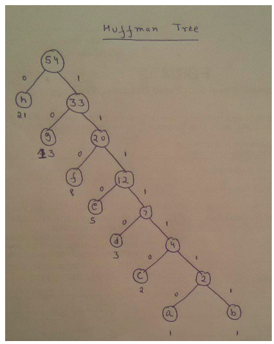
Problem 2 huffman tree

Slide 26
Problem
3. A networking company uses a compression technique to encode the message before transmitting over the network. Suppose the message contains the following characters with their frequency:
Characters | Frequency
A | 5
B | 9
C | 12
D | 13
E | 16
F | 45
Note that each character in input message takes 1 byte.
If the compression technique used is Huffman Coding, how many bits will be saved in the message?
Solutions: Finding number of bits without using Huffman, Total number of characters = sum of frequencies = 100 size of 1 character = 1byte = 8 bits Total number of bits = 8*100 = 800
Using Huffman Encoding, Total number of bits needed can be calculated as:
5*4 + 9*4 + 12*3 + 13*3 + 16*3 + 45* 1 = 224
Bits saved = 800-224 = 576.

Slide 27
Problem 3 huffman tree

Slide 28
Job Scheduling with Deadline

Slide 29
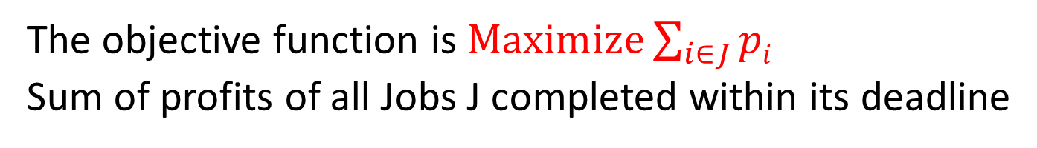
Problem Statement
The problem is stated as below.
There are n jobs to be processed on a machine.
Each job i has a deadline d_{i}≥ 0 and profit p_{i}≥0 .
p_{i} is earned iff the job is completed by its deadline.
The job is completed if it is processed on a machine for unit time.
Only one machine is available for processing jobs.
Only one job is processed at a time on the machine.
The objective function is $Maximize\sum_{i∈J}{pi}$
Sum of profits of all Jobs J completed within its deadline
Notes:
Each task in the decending order of their profit and schedule it in the Latest possible free slot that meets its deadline . If no such slot is there don’t schedule the task.

Slide 30
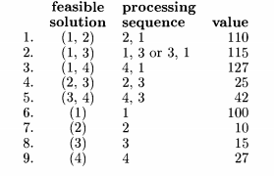
n = 4, (p1,p2,P3,P4) = (100,10,15,27) and (d1,d2, d3,d4)=(2,1, 2,1)

Slide 31
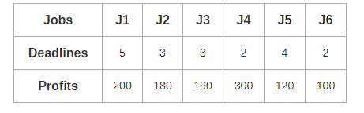
Example Problem

Slide 32
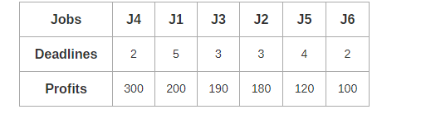
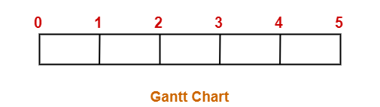
Step-1:
Sort all the given jobs in decreasing order of their profit-
Step-02:
Value of maximum deadline = 5.
So, draw a Gantt chart with maximum time on Gantt chart = 5 units as shown-

Slide 33
Further Steps are done in this way
0
1
2
3
4
5
 | J4
0
1
2
3
4
5
 | J4 |  |  | J1
0
1
2
3
4
5
 | J4 | J3 |  | J1
0
1
2
3
4
5
J2 | J4 | J3 |  | J1
0
1
2
3
4
5
J2 | J4 | J3 | J5 | J1

Slide 34
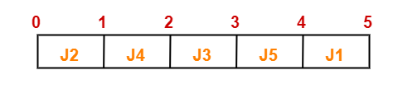
The optimal schedule is-
J2 , J4 , J3 , J5 , J1
Maximum earned profit
= Sum of profit of all the jobs in optimal schedule
= Profit of job J2 + Profit of job J4 + Profit of job J3 + Profit of job J5 + Profit of job J1
= 180 + 300 + 190 + 120 + 200
= 990 units

Slide 35
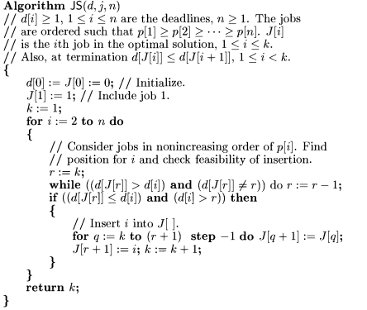
Algorithm

Slide 36
Algorithm

Slide 37
Algorithm:

